Slide 1

Binary Search Trees Analysis
Ido Begun, Yael Harel & Idan Shabat

Slide 2

Contents
BST definition
Our goal
The CFG algorithm
Assumptions on the program
Concrete states lattice
BST strings
Abstract states lattice
The Galois connection
Transformers
Obstacles and solutions
Optimizations and future ideas

Slide 3
Binary Search Trees
A common database, used for storing data with comparable elements.
Integers, strings etc.
Abbr. BST
For each node with value d:
If a node in the left subtree has value d’: d’ ≤ d
If a node in the right subtree has value d’: d ≤ d’
6
2
6
-1
5
10

Slide 4
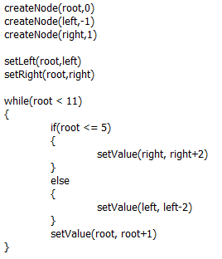
BST Programs
Programs that uses BSTs should keep them valid, while supporting operations like:
Insertions
Setting values
Setting children
Goal: given such program, verify that all of the BSTs created in it are valid (at the end point of the run).

Slide 5
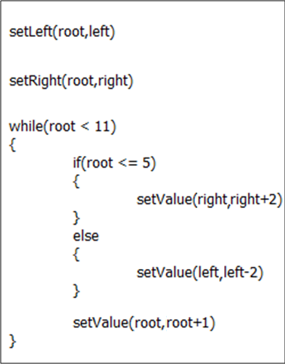
The CFG Algorithm
Create the CFG of the program.

Slide 6
The CFG Algorithm
Initialize all the CFG nodes with the empty abstract state.
ε
ε
ε
ε
ε
ε
ε
ε
ε
ε

Slide 7
The CFG Algorithm
Choose a node in the CFG and update it:
For nodes after if or else: State = Previous State П Boolean Statement, or State = Previous State П !(Boolean Statement)
For nodes after if blocks, and before while: State = Previous States
For nodes after other commands: State = [command]#(Previous State)
Continue the process (according to a certain order of the CFG nodes), until a fix point is reached, or until we had enough iterations.
П

Slide 8
Assumptions on the Program
The values of the BST nodes are integers.
The following commands are supported:
createNode(n,d) – creates a new node with value d.
setLeft(n,n’) – sets the left child of n to be n’.
setRight(n,n’) – sets the right child of n to be n’.
setValue(n,d) – sets the value of n to be d.
setValue(n,n+d) – increments the value of n by d.
setValue(n,n-d) – decrements the value of n by d.
The programs use the commands properly:
There is no createNode(n,d) if n is already created.
All nodes names inside the set-commands should exist.

Slide 9
Concrete States Lattice
N denotes the set of nodes in the program.
N⁺ = N ᴜ {null}
A concrete state is a finite set of partial functions s: N → N⁺× Z × N⁺
If s(n) = (n_{l} , d , n_{r}), then s(n_{l}) and s(n_{r}) are defined.
Partial order:
Join: , Meet:
Bottom: ø
Top: T - A special additional element.
Ul
U
U

Slide 10
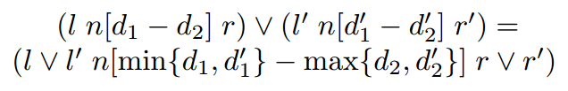
BST-strings
A BST-string is made of matched parentheses, and represents a BST with a range of values at each node:
Join (of BST-strings): V =
n₀
4-5
((n₁[0-2]) n₀[4-5](n₂[6-6]))
n₁
n₂
0-2
6-6
n₀
n₀
n₀
4-4
4-5
4-5
n₁
n₁
n₂
n₁
n₂
0-1
2-2
6-6
0-2
6-6

Slide 11
BST-strings
And what if there are different nodes in the same location in the trees? V =
n_{τ} is a “general node” – may represent each node in N.
For two BST-strings w₁,w₂: w₁≤w₂ ↔ w₂=w₁ V w₂
Meet is defined analogously.
meet of two different nodes = the empty string.
n₀
n₀
n₀
4-4
4-5
4-5
n₁
n₃
n₂
n_{τ}
n₂
0-1
2-2
6-6
0-2
6-6

Slide 12

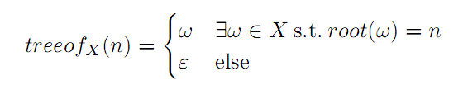
Abstract States Lattice
An abstract state is a set of BST-strings.
Different BST-strings don’t have the same root.
Partial order:
Join:
where:
Meet is defined analogously.
Bottom: ø
Top: τ - A special additional element.

Slide 13

The Galois Connection
α – Use function down on root nodes.
Given s and a node n, s.t. s(n) = (n_{l} , d , n_{r}), down_{s}(n) = (down_{s}(n_{l}) n[d-d] down_{s}(n_{r}))
down_{s}(null) = ε
n is a root node of s if it has no parent in s
i.e. no n’ satisfy s(n’)=(n,…) or s(n’)=(…,n)
Only for S without “cycles”. For such S: α(S) = τ

Slide 14

The Galois Connection
γ – Can be defined automatically by α.
n₀
n₀
4-5
6-9
n₁
n₂
n_{τ}
0-2
6-6
1-4
n₀
n₀
n₀
n₀
4
5
9
8
n₀
n₀
n₁
n₂
n₀
4
n₅
n₁
1
6
5
3
7
1
n₂
n₁
n₂
6
0
6

Slide 15
Transformers – Create Node
The concrete transformers ignore s’s that aren’t valid to the next command.
E.g. if s(n) is defined, [createNode(n,d)] will ignore s.
For an abstract state X:
n₀
n₃
n₀
n₃
4-5
6-9
[createNode(n₀ ,7)]#
4-7
6-9
n₁
n₂
n_{τ}
n₁
n₂
n_{τ}
0-2
6-6
1-4
0-2
6-6
1-4
n₀
n₃
n₀
n₃
n₄
4-5
6-9
[createNode(n₄ ,3)]#
4-5
6-9
3-3
n₁
n₂
n_{τ}
n₁
n₂
n_{τ}
0-2
6-6
1-4
0-2
6-6
1-4

Slide 16
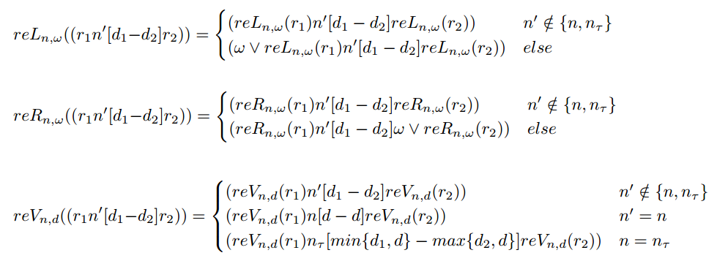
Replacement Functions
For the set-commands, we define replacement functions:
In words:
reL_{n,w} joins the existing left children of n with w.
reR_{n,w} joins the existing right children of n with w.
reL_{n,d} joins or replaces the existing value of n with d.

Slide 17
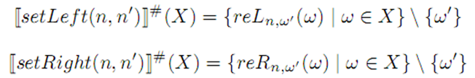
Transformers – Setters
For an abstract state X, if ω’=treeof_{X}(n’):
n₃
6-9
n₄
n₀
n₃
n₀
n₀
0-0
4-5
6-9
[setLeft(n₀ , n₄ )]#
4-5
1-4
n₁
n₂
n₀
n_{τ}
n₂
n₄
1-2
6-6
1-4
0-2
6-6
0-0
n₃
6-9
n₄
n₀
n₃
n₀
n_{τ}
0-0
4-5
6-9
[setRight(n₀ , n₄ )]#
4-5
1-4
n₁
n₂
n_{τ}
n₁
n_{τ}
n₄
1-2
6-6
1-4
0-2
0-6
0-0
n₀
n₃
n₀
n₃
4-5
6-9
[setLeft(n₂ , n₇ )]#
4-5
6-9
n₁
n₂
n_{τ}
n₁
n₂
n_{τ}
0-2
6-6
1-4
0-2
6-6
1-4

Slide 18
Transformers – Setters
For an abstract state X:
n₀
n₁
n₀
n₁
4-5
6-9
[setValue(n₁ ,5)]#
4-5
5-5
n₁
n₂
n_{τ}
n₁
n₂
n_{τ}
0-2
6-6
1-4
5-5
6-6
1-5
n₀
n₁
n₀
n₁
4-5
6-9
[setValue(n₄ ,0)]#
4-5
6-9
n₁
n₂
n_{τ}
n₁
n₂
n_{τ}
0-2
6-6
1-4
0-2
6-6
0-4
n₀
n₁
n₀
n₁
4-5
6-9
[setValue(n₄ ,0)]#
4-5
6-9
n₁
n₂
n₃
n₁
n₂
n₃
0-2
6-6
1-4
0-2
6-6
1-4

Slide 19

Transformers
All of the abstract transformers are sound, with respect to their matched concrete transformers.
i.e. for all X:

Slide 20
Obstacles and Solutions
setLeft(a,b) – what to do with the existing child?
Also, we can assume that the user won’t write setLeft(a,b), if a already has a left child.
a
What about c? What if the user try to access it?
b
d
a
b
a
c
What if c=n_{τ}? We forbid trees with root n_{τ} .
c
d
b
d
a
This option is sound.
n_{τ}
d

Slide 21
Obstacles and Solutions
What should the concrete and abstract transformers do with invalid commands?
E.g. setLeft(b,c) where b doesn’t exist
Solution: If ƎsϵS : s(b) is undefined, f(S)=T.
a
a
c
b
d
b
d
Not sound.
Better solution: Ignore the invalid situations.
f(S) = f(S∩{s(b) is defined})
c
Пl
a
c
T
d

Slide 22
Obstacles and Solutions
More problems that we have faced:
Top elements in concrete and abstract lattices.
Abstract states can’t contain ε.
Invalid concrete and abstract states (“cycles”).
createNode inside an if block.
In what order should we scan the CFG nodes?

Slide 23
Code Example
createNode(root,0)
createNode(left,-1)
createNode(right,1)
setLeft(root,left)
setRight(root,right)
while(root < 11)
{
if(root <= 5)
{
setValue(right,root+10)
}
else
{
setValue(left,root-10)
}
setValue(root,root+1)
}

Slide 24
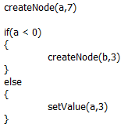
Optimizations and Further Ideas
Support deletions and setLeft to existing children.
Get rid of n_{τ} : Keep a set of names instead.
Not consider impossible cases.
c
…
a
b
a
d
e
[setLeft(a,b)]#
n_{τ}
d
b
d
a
c,e,f
d
Should we create b?

Slide 25
Questions?
Thank you

